Slide 1
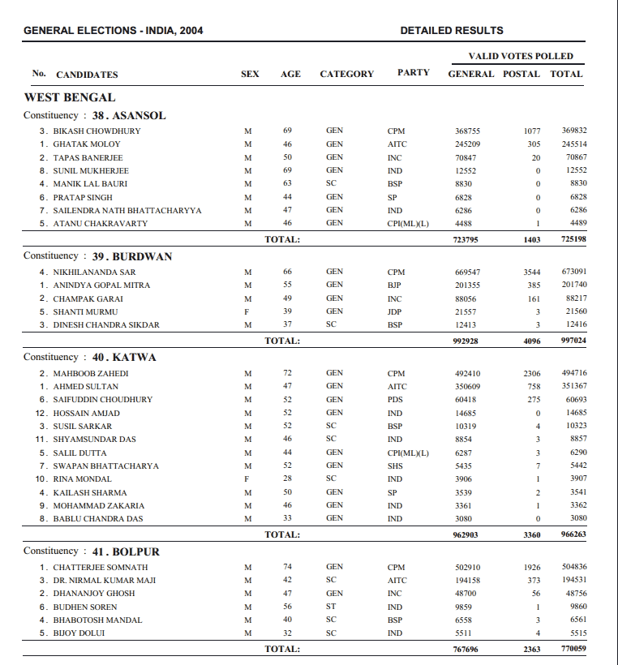
The ECI website has this data.

Slide 2
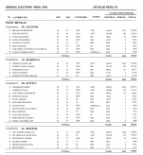
The ECI website has this data.

Slide 3
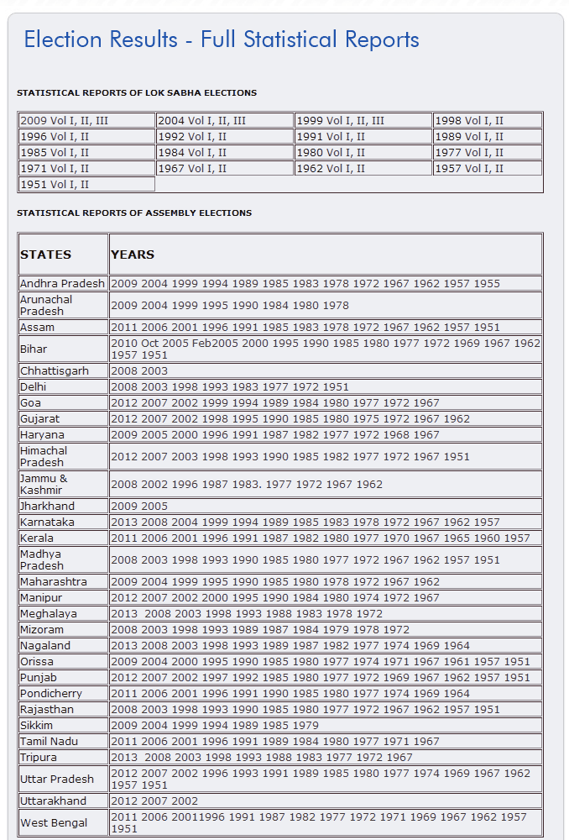
… and, most of the data is in PDFs

Slide 4
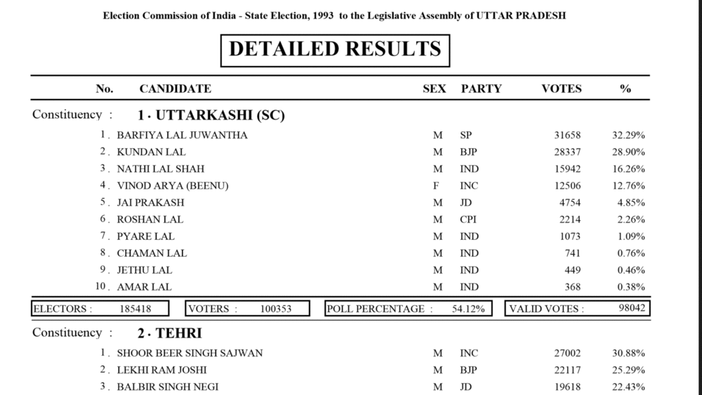
The PDF files have a reasonably clear structure

Slide 5
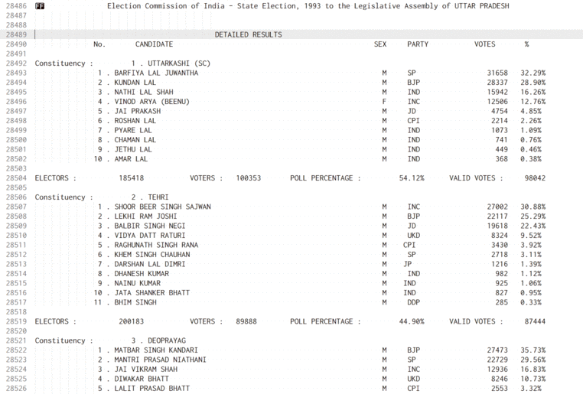
… that translates into text that can be parsed

Slide 6
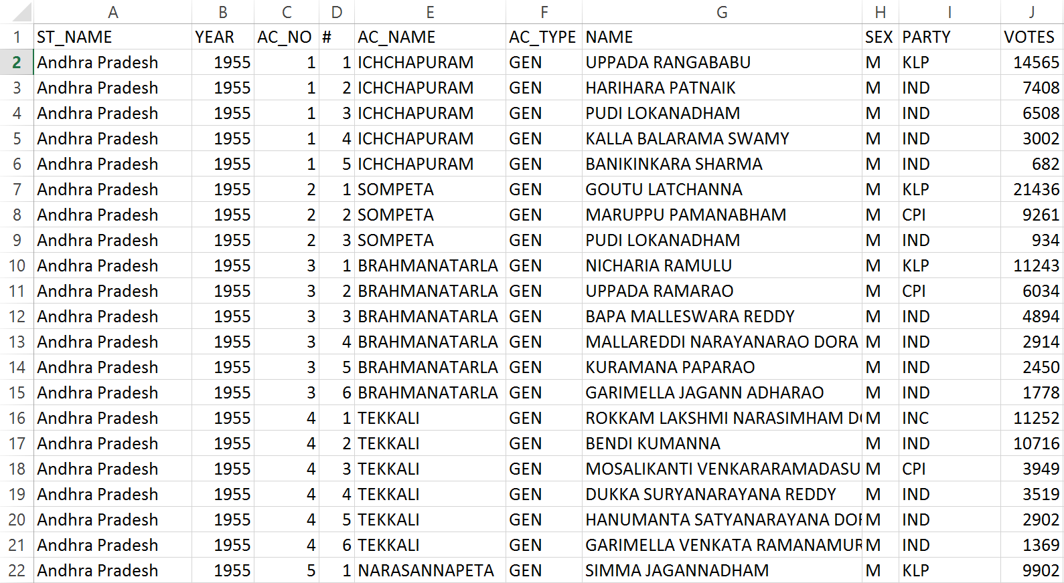
… which, with some effort, can be converted into a structured format
… and at this point, we need to start checking for errors.

Slide 7
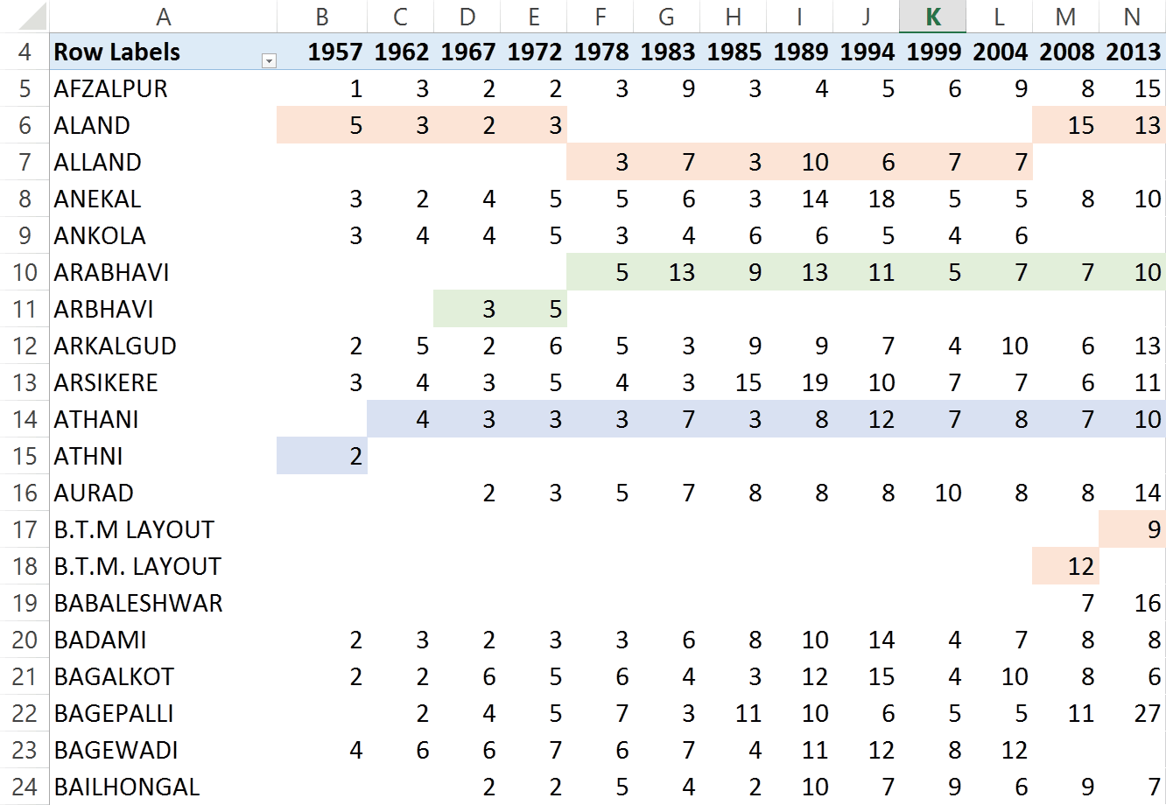
At this point, we start checking what’s gone wrong
Each row here is one constituency.
The number of candidates that have contested in each constituency in every year is shown as a table.
You can see that some patterns emerge here.

Slide 8
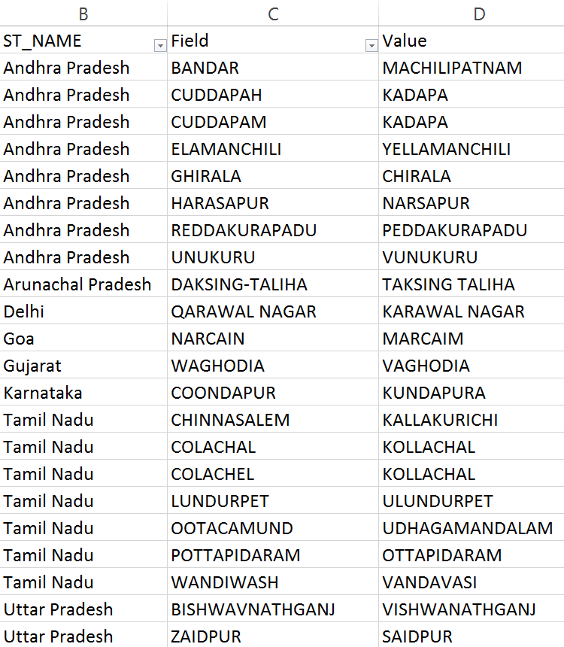
Not every spelling error is easily identifiable by the first letter
Parties are mis-spelt
MADMK
MAMAK
MDMK
Party names change
AIADMK
ADMK
ADK
Parties restructure
INC(I)
INC
Constituency names mis-spelt
BHADRACHALAM
BHADRACHELAM
BHADRAHCALAM

Slide 9
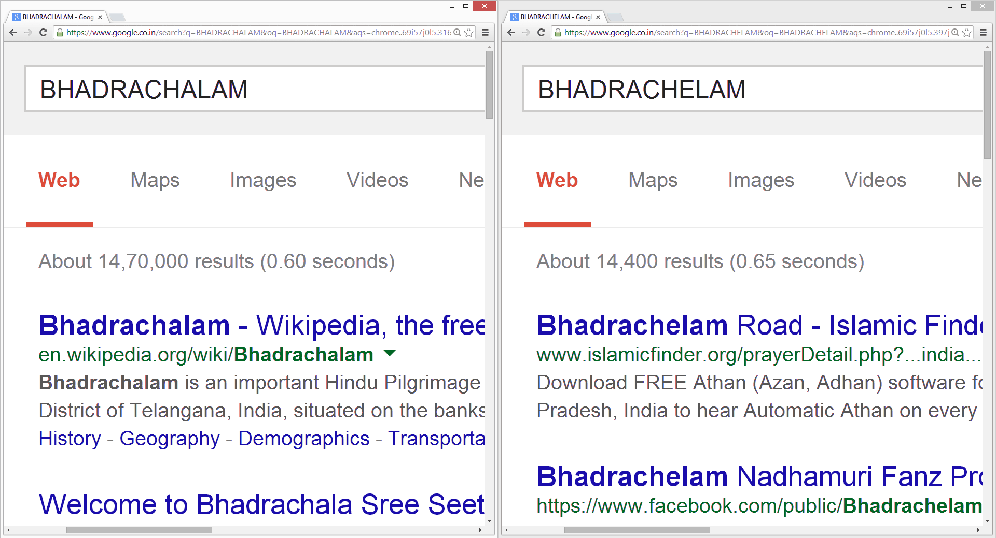
Fortunately, large scale data itself can provide a solution

Slide 10
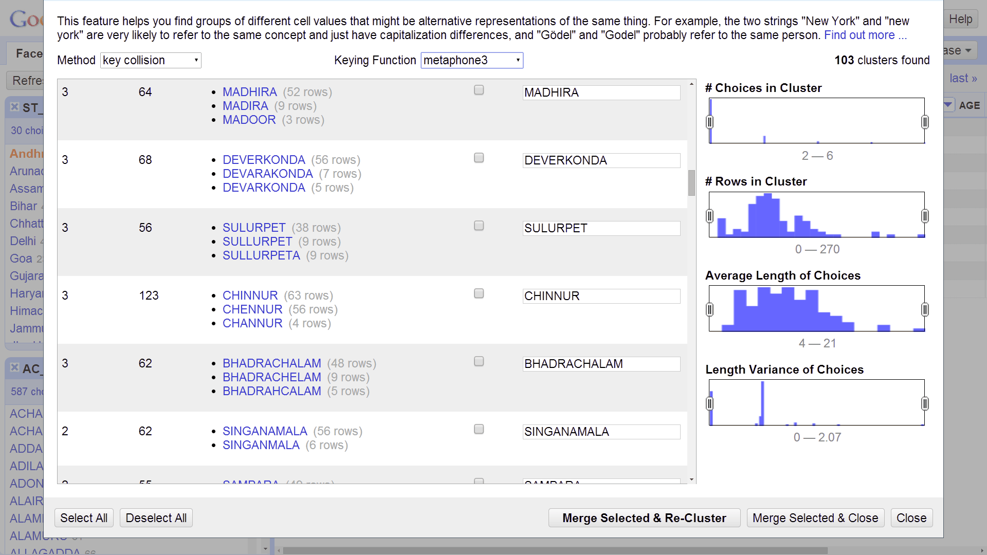
… with modern tools that support machine learning

